Slide 1

“Caring Enough to
Tell the Truth”
4:12 – 20
Week 9
16 March 2022

Slide 2

Galatians Overview
In this chapter Paul continues and concludes his defense of the gospel of justification by faith in Christ, in contrast to seeking justification by the works of the Law.
The practical argument continues in the first part of chapter four as Paul describes the condition of those under the Law prior to the coming of Christ. They were “children,” and really no different than slaves.
But when Christ came, He redeemed those under the Law and made it possible for them to receive the adoption as “sons” (1-5).

Slide 3
Galatians Overview
A special blessing of this sonship was receiving the Holy Spirit in their hearts, and now they are no longer as a slave but as a son and an heir of God through Christ (6-7).
Paul then argues along sentimental lines. After having come to know the true God and being recognized by Him, their observance of holy days is indicative of a desire to return to bondage (8-11).
That greatly concerns Paul, who would have them become like him. He reminds them of their reception of him in the past, and he hopes that by telling them the truth he has not become their enemy (12-16).

Slide 4
Galatians Overview
Wishing he could be with them in person and use a different tone, he feels like a woman going through labor again as he seeks to ensure that Christ is formed in them. All of this because he has doubts about them (17-20).
His final argument is an appeal to the Law itself, addressed directly to those who desire to be under it. He reminds them of Abraham's two sons by Sarah and Hagar, and contends there are allegorical implications concerning the two covenants (21-22).

Slide 5
Galatians Overview
Hagar, the bondwoman who gave birth to Ishmael, represents the covenant given at Mt. Sinai, and corresponds to physical Jerusalem and the bondage of those under the Law (24-25).
Sarah, Abraham's wife who gave birth to Isaac, represents the new covenant and corresponds to the heavenly Jerusalem which offers freedom to all who accept it (26-28).
With a reminder that those born of the Spirit can expect persecution by those born according to the flesh, Paul concludes his defense of the gospel of justification by faith in Christ by proclaiming that those in Christ are not of the bondwoman but of the free (29-31).

Slide 6

“Caring Enough to
Tell the Truth”

Slide 7
Galatians Overview
Here we see that Paul was not only a passionate preacher of grace and a firm, uncompromising teacher of truth but also a caring shepherd among the flock. It is easy to lose sight of the deep love and genuine concern Paul had for the Galatians when he called them fools and accused them of backsliding into false teaching. Galatians 4:12-20 helps balance that out.
In this part of his letter, Paul’s appeal to his readers becomes a heart-to-heart talk rather than a doctrinal discourse. Here the teacher comes across as a warm, tender, transparent, and vulnerable pastor. We are to love people as much as we love the truth. Championing the gospel isn’t about winning or losing arguments. It’s about God’s people gaining or losing freedom.

Slide 8
Galatians Overview
In the first three chapters of this letter, Paul mustered his biblical, historical, theological, and experiential arsenal against the Judaizers’ false gospel. His goal was to demolish their accusations against his apostleship and expose their false doctrine of justification and sanctification through the Law.
In chapter 4, his tone begins to change. He moves from defending to exhorting, from challenging to complimenting, from refuting to remembering. Paul the vigorous apologist becomes Paul the loving and caring pastor. He pleads with the Galatians believers, his spiritual children in the Lord, to return to the truth they had once embraced.

Slide 9
Galatians 4:12 – 14
¹²I plead with you, brothers and sisters, become like me, for I became like you. You did me no wrong. ¹³As you know, it was because of an illness that I first preached the gospel to you, ¹⁴and even though my illness was a trial to you, you did not treat me with contempt or scorn. Instead, you welcomed me as if I were an angel of God, as if I were Christ Jesus himself.

Slide 10
Galatians 4:12 – 14
Paul had been a proud, self-righteous Pharisee, trusting in his own righteousness to save him (Phil 3:4–6). But when he came to Christ, he abandoned all efforts to save himself, trusting wholly in God’s grace (Phil 3:7–9). He urged the Galatians to follow his example and avoid the legalism of the Judaizers.
Paul wanted the Galatians to become like him—delivered from the bandage of the Law and freed to know Christ as Savior. But Paul also said that he had become like the Galatians (4:12). In what sense had Paul become like them? Most likely this refers to Paul’s practice of becoming “all things to all men” in order to open the door for evangelism (1Cor 9:22). To Jews, Paul became like a Jew; to those without the Law, he became like one without the Law.

Slide 11
Galatians 4:12 – 14
So, when Paul first came to the Gentile Galatians, he didn’t remain aloof as Peter did in Antioch, but he identified with them by adopting many of their customs. Paul spoke their language, ate their food, respected their culture, and met them where they were.
You have not injured me or “done me no wrong.” Though the Jews persecuted him when he first went to Galatia, the Galatian believers had not harmed Paul, but had enthusiastically received him when he preached the gospel to them. How, Paul asked, could they reject him now? Some think the illness Paul refers to was malaria, possibly contracted in the coastal lowlands of Pamphylia. That could explain why Paul and Barnabas apparently did not preach at Perga, a city in Pamphylia (cf. Acts 13:13-14).

Slide 12
Galatians 4:12 – 14
Others suggest Paul suffered from epilepsy brought on by some kind of wicked spirit (2Cor 12:7-10). Still others proposed that Paul was experiencing a disease of the eyes. In light of Paul’s statement in Gal. 4:15 – “if possible, you would have plucked out your eyes and given them to me” – many conclude that Paul suffered from some affliction of his eyesight. Poor eyesight may also explain why Paul points out the “large letters” he used to write with his own hand (6:11).
Whatever Paul’s condition, it apparently made him disturbing to look at. His illness was a “trial” or test for the Galatians and would normally have caused most people to “despise or loathe” him (4:14).

Slide 13
Galatians 4:12 – 14
On the contrary, they welcomed Paul, showing him the same respect and kindness they would have shown an angel or even Jesus Himself. Such was their warm and hospitable reception of Paul at the beginning of his ministry among them. Early on they were open to the gospel and overflowing with the love and mercy characteristic of those who had experienced the power of transforming grace.
It is a wonderful thing when people accept God’s servants, not because of their outward appearance, but because they represent the Lord and those who bring His message.

Slide 14
Galatians 4:15 – 16
¹⁵What has happened to all your joy? I can testify that, if you could have done so, you would have torn out your eyes and given them to me. ¹⁶Have I now become your enemy by telling you the truth?

Slide 15
Galatians 4:15 – 16
But things had changed. They had lost the “sense of blessing” they originally had toward Paul. They had received Paul with joy, congratulating themselves that the apostle had preached in their midst. Their appreciation knew no limits; they would even have made the sacrifice of their eyes for Paul (4:15). While some think this is an indication that Paul had a disease of the eyes: his “thorn” in his flesh (2Cor 12:7), the evidence is not conclusive.
This may simply be a bold figure of speech to convey the high esteem the Galatians once had for the apostle—they would have given him their most precious possession. In either case, it reflects the great love the Galatians had initially expressed for the apostle.

Slide 16
Galatians 4:15 – 16
Now, the Galatians had become so confused that, in spite of their previous affection for Paul, some had come to regard him as their enemy.
The apostle reminds them that he had not harmed them, but merely told them the truth (4:16)—a truth that had once brought them great joy.
How fickle were these Galatians! They were turning against the Lord, the gospel of grace, and the messenger who brought them the news of justification by faith.

Slide 17
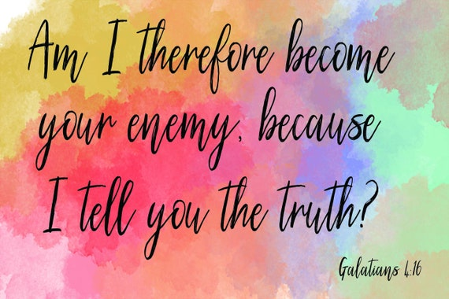

Slide 18
Galatians 4:17 – 20
¹⁷Those people are zealous to win you over, but for no good. What they want is to alienate you from us, so that you may be zealous for them. ¹⁸It is fine to be zealous, provided the purpose is good, and to be so always and not just when I am with you. ¹⁹My dear children, for whom I am again in the pains of childbirth until Christ is formed in you, ²⁰how I wish I could be with you now and change my tone, because I am perplexed about you!

Slide 19
Galatians 4:17 – 20
In contrast to Paul’s heartfelt plea on behalf on the truth, the Judaizers had an insidious and insincere agenda. They sought out the young Galatian converts with zeal (4:17). In addition to open attacks on Paul in his absence, the Judaizers also drummed up disingenuous flattery.
Although they showered the Galatians with compliments—a practice Paul deemed good when combined with the right motives (4:18)—these legalists were doing it to spotlight themselves and enslave the Galatians under their version of the Law.

Slide 20


Slide 21
Galatians 4:17 – 20
So, with the tender heart of a pastor, Paul explained that his motive had always been to serve the Galatian believers until Christ was formed in them (4:19). This expression describes the Christian life as a kind of reincarnation of Christ in a believer’s life. This is in fact God’s ideal and purpose—for Christ to live His life in and then through each believer (cf. Gal. 2:20).
Like a mother struggling through labor (travail), Paul wanted to endure this agonizing crisis of their faith until the image of Christ could be wrought in their lives. Paul had been “in labor” once before, when he preached the gospel to them for their salvation. Now he was enduring again as he struggled to see them grow in Christ and be delivered from the false teachers.

Slide 22
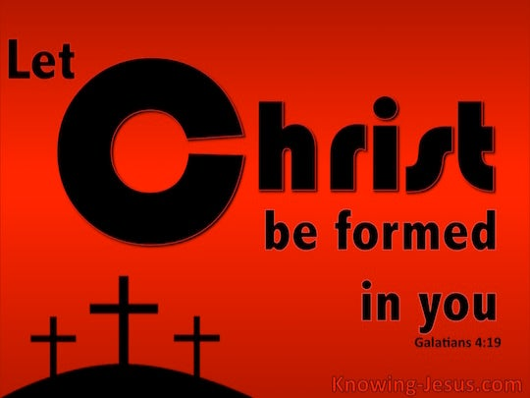

Slide 23
Galatians 4:17 – 20
As any parent knows, becoming a parent is far easier than being a parent. Just like any loving parent, Paul would rather have been present with the Galatians than far removed from them. Paul had a deep desire to be with them so that he could speak gently, though firmly, concerning his grave concerns (4:20).
Perhaps an in-person visit would help resolve some of the perplexity he experienced at the news of their backsliding. Perhaps he could better diagnose their disease, apply a proper salve, and restore them to health.

Slide 24
Galatians 4:17 – 20
Under these circumstances, Paul could change his tone from one of rebuke to one of loving exhortation. But writing from a distance, Paul had to resort to emergency measures to stop the bleeding—measures that can be painful for the patient. In the case of the Galatians, the truth hurt.
No doubt Paul had heard of the words of Jesus spoken nearly twenty years earlier > “You will know the truth, and the truth will make you free” (John 8:32).
If the Galatians needed anything during this great crisis in their Christian lives, it was freedom. Yet the only way to achieve that freedom was to know the truth.

Slide 25

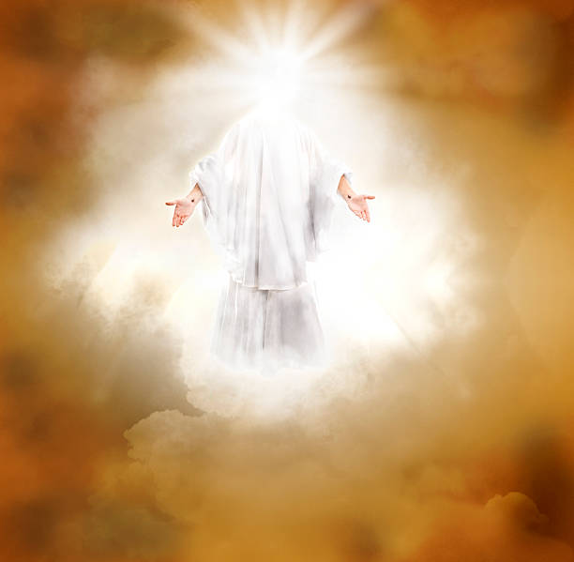

Slide 26
NEXT CLASS – 23 March 2022
Book of Galatians
Before next class, read the below verses in the KJV and the NIV, plus one additional versions of the Bible, i.e., NRSV, NLT, NKJV, etc …
Chapter 4:21 – 31
“To Those Who Want to be Under the Law”
EBC Website for Handouts
https://bit.ly/surveyofpaulineepistles

